Slide 1

NIOS II Emulator
Increment 2 Retrospective

Slide 2
Overview
Project Description
Use Case Model
Use Case Diagram
Use Cases
Domain Model
Class Diagram
(Activity Diagrams)
Sequence Diagrams
(State Machine Diagrams)
Reflection

Slide 3
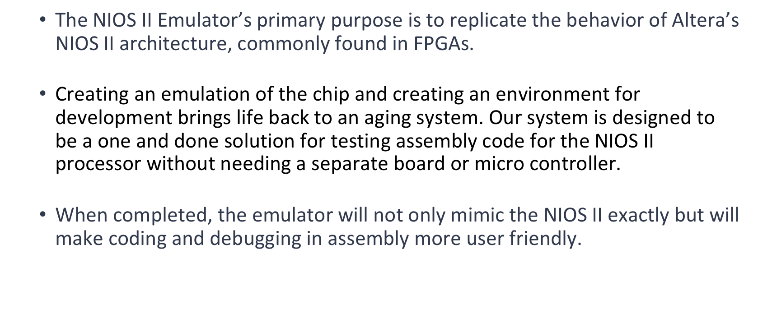
Project Overview

Slide 4
Overview
Project Description
Use Case Model
Use Case Diagram
Use Cases
Domain Model
Class Diagram
(Activity Diagrams)
Sequence Diagrams
(State Machine Diagrams)
Reflection

Slide 5
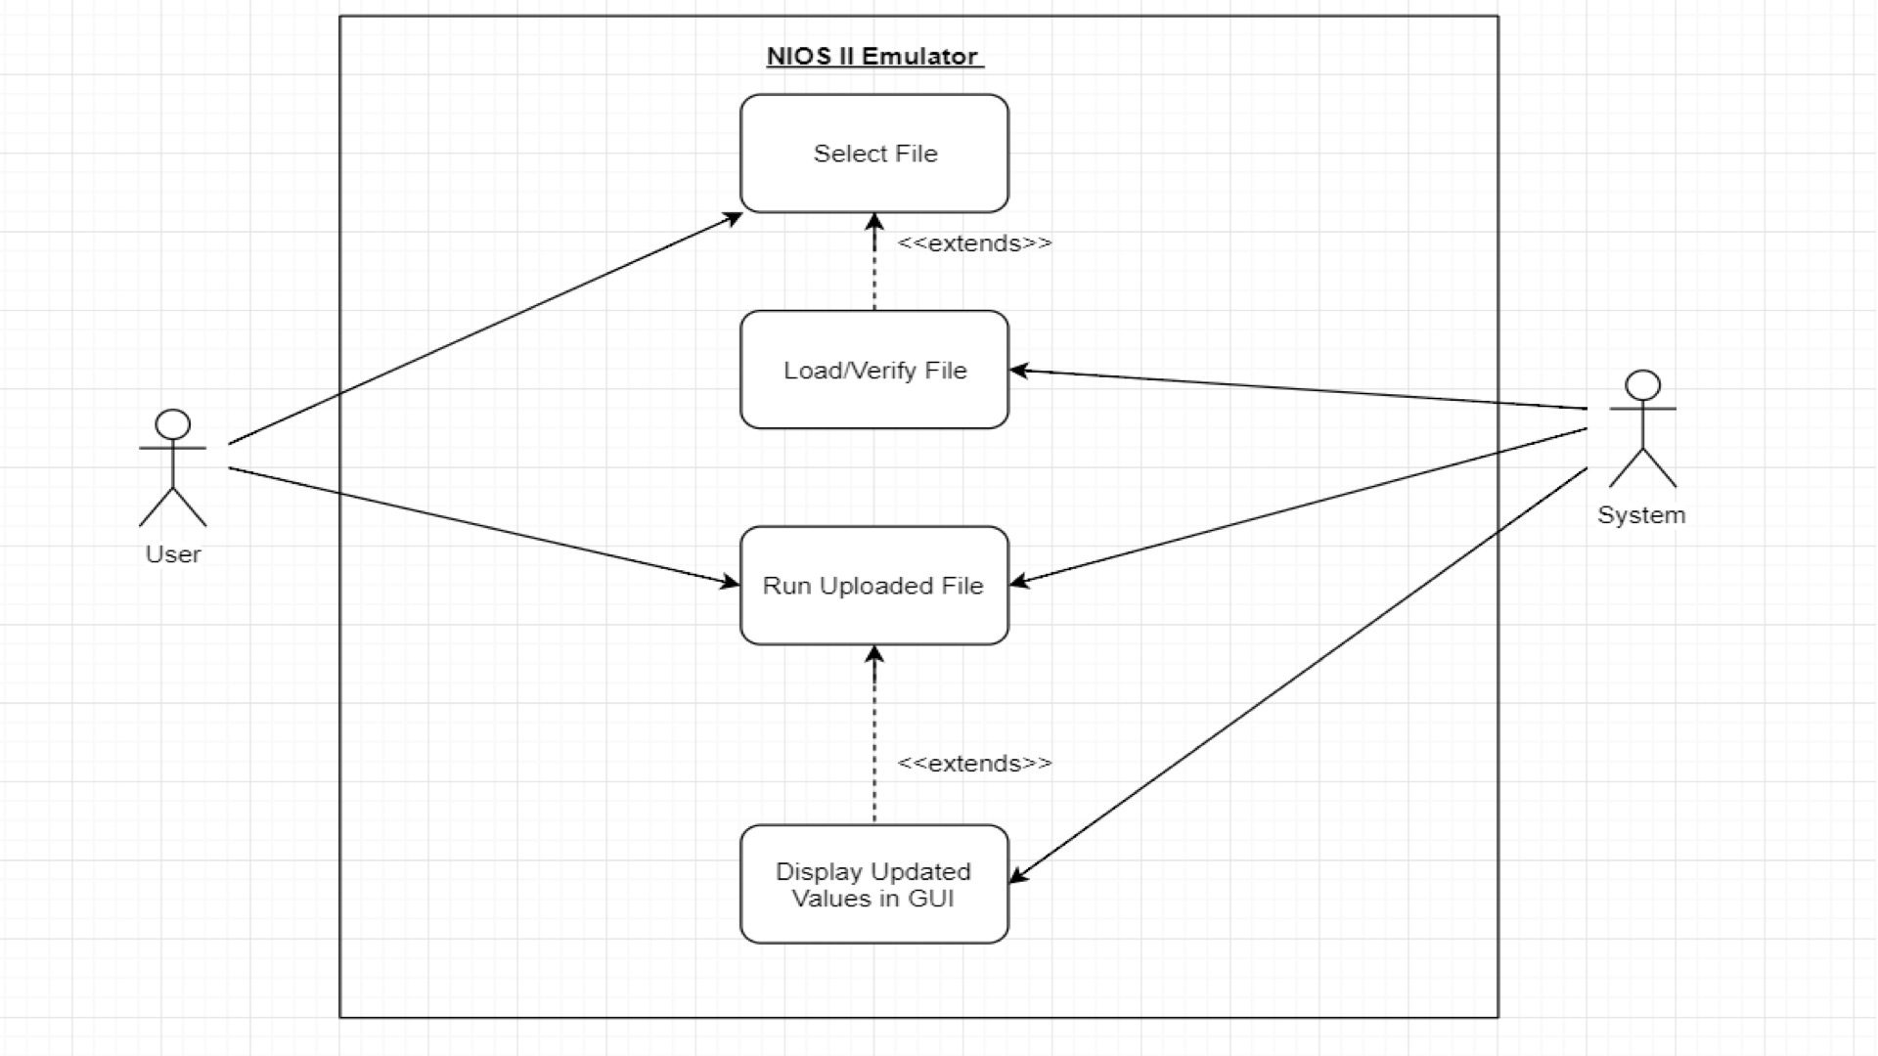
Use Case
Diagram

Slide 6
Use Case:
Name | ValidateFile
Actor | SYSTEM
Entry Condition: | SYSTEM is not running.
Flow: | User inputs text file Text file is parsed and checked for code errors
Exit Condition: | File has not code errors

Slide 7
Use Case:
Name | RunProgram
Actor | USER
Entry Condition: | File is successfully loaded and passes validation
Flow: | User presses run File is executed to completion
Exit Condition: | File instructions are run until completion or program is paused/restarted

Slide 8
Use Case:
Name | RestartProgram
Actor | USER
Entry Condition: | Program is paused
Flow: | Reset program counter to 1 Reset Registers Display Registers
Exit Condition: | Program counter is 1 and program is paused waiting to be executed

Slide 9
Use Case:
Name | PauseProgram
Actor | USER/SYSTEM
Entry Condition: | Program is running.
Flow: | Pause program Display Registers
Exit Condition: | Program is paused with the registers being displayed.

Slide 10
Use Case:
Name | ProgramFinished
Actor | SYSTEM
Entry Condition | Program has executed all lines
Flow | Display Registers
Exit Condition | Program is paused with the registers being displayed

Slide 11
Use Case:
Name | ReUploadFile
Actor | SYSTEM
Entry Condition | File has been ran and USER wants to upload new file
Flow | Reset Registers ValidateFile
Exit Condition | New file is valid. Program is Paused

Slide 12
Overview
Project Description
Use Case Model
Use Case Diagram
Use Cases
Domain Model
Class Diagram
(Activity Diagrams)
Sequence Diagrams
(State Machine Diagrams)
Reflection

Slide 13
Structural Model

Slide 14
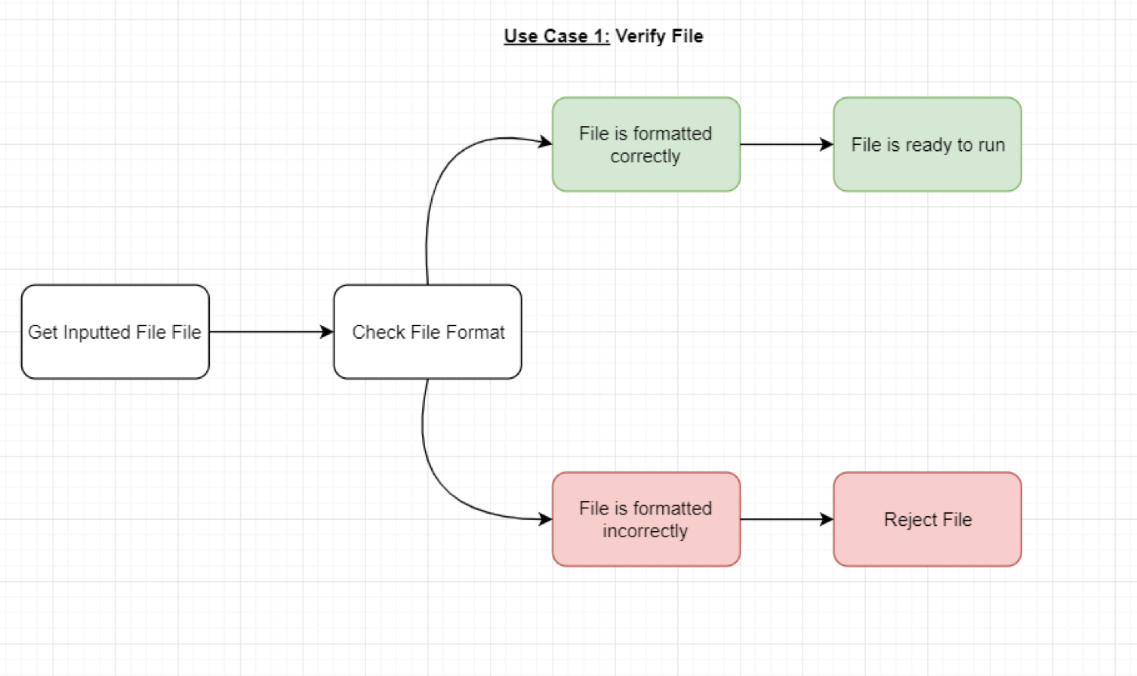
Dynamic Model

Slide 15
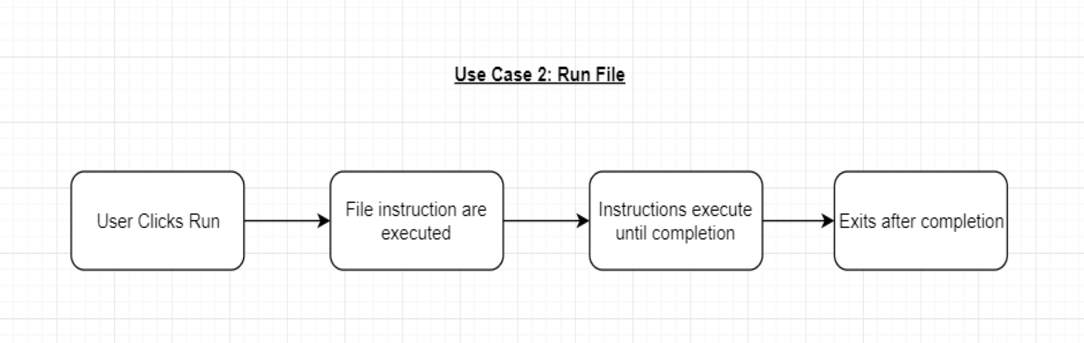
Dynamic Model

Slide 16
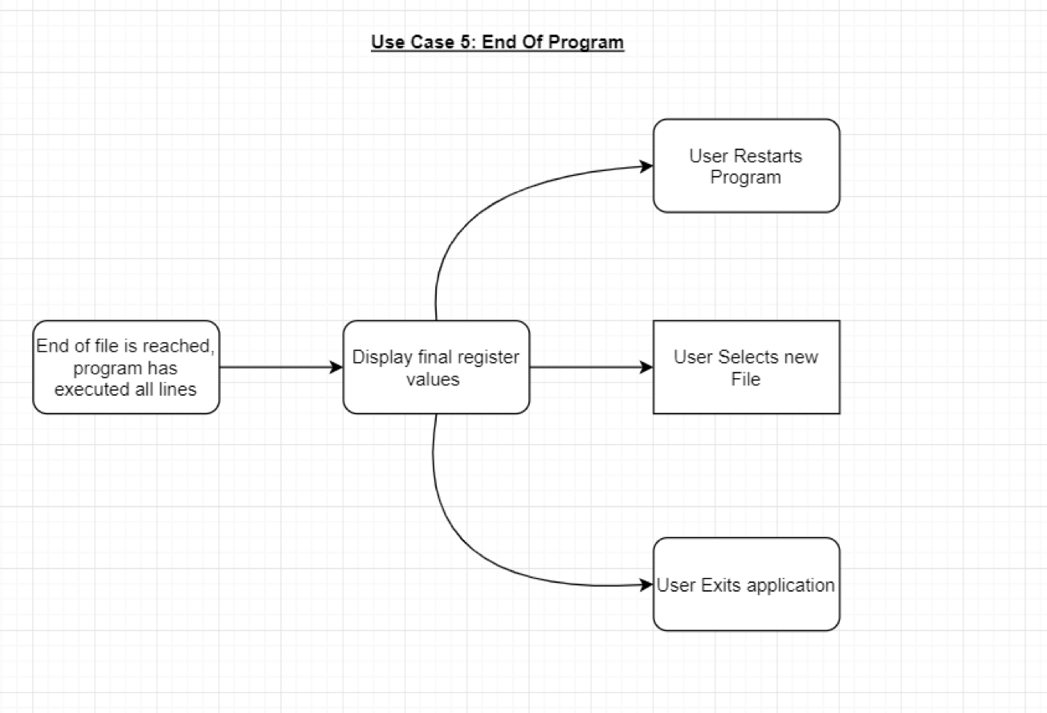
Dynamic Model

Slide 17
Overview
Project Description
Use Case Model
Use Case Diagram
Use Cases
Domain Model
Class Diagram
(Activity Diagrams)
Sequence Diagrams
(State Machine Diagrams)
Reflection

Slide 18
Reflection What went well
Uses cases allowed us to think about the flow of our system
We were able to put pen to paper and discuss lots of design details
As a group we were able to answer and ask questions, that gave us a better understanding of the system

Slide 19
Reflection What didn’t go well
Our design of the NIOS II Processor emulator uses very little object oriented design
Class diagram does not accurately show the system
Our understanding of how certain models were suppose to look took longer than anticipated

Slide 20
Reflection Something to Improve
Design of RAD needs updated since use cases have been added
Looks cluttered
Need figure descriptions
Possible LaTeX utilization for better formatting
Implement different object model to better fit our system

Slide 21
Overview
Project Description
Use Case Model
Use Case Diagram
Use Cases
Domain Model
Class Diagram
(Activity Diagrams)
Sequence Diagrams
(State Machine Diagrams)
Reflection

